Slide 1
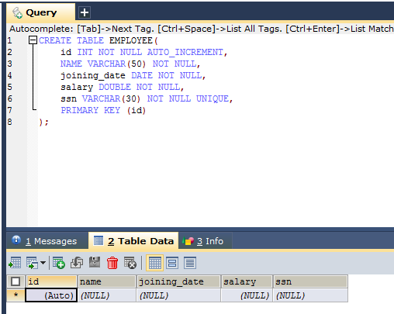
Spring 4 + Hibernate 4 + MySQL+ Maven Integration example (Annotation based configuration)
Create Schema in database

Slide 2
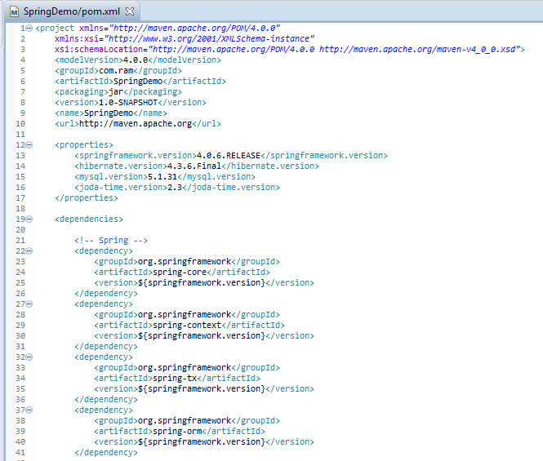
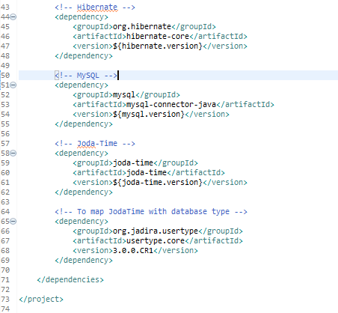
Spring 4 + Hibernate 4 + MySQL+ Maven Integration example (Annotation based configuration)
Update pom.xml to include required dependencies

Slide 3
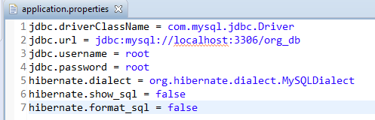
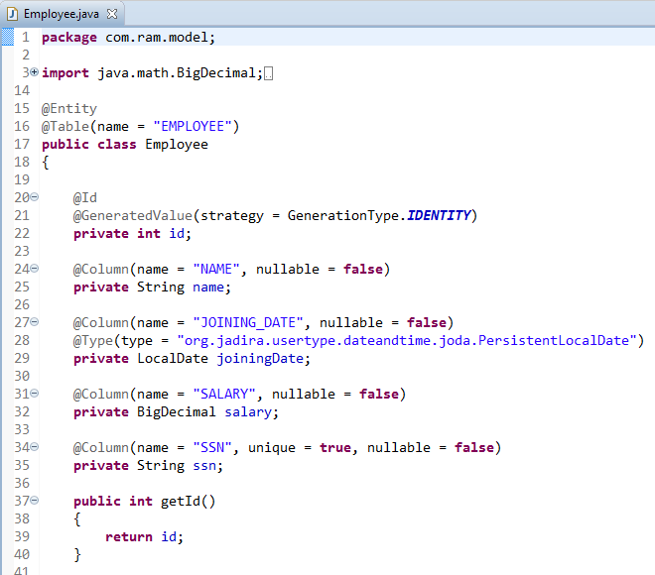
Spring 4 + Hibernate 4 + MySQL+ Maven Integration example (Annotation based configuration)
Properties file
Create Domain Entity Class(POJO)

Slide 4
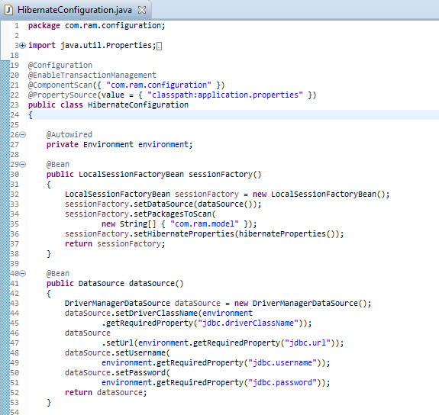
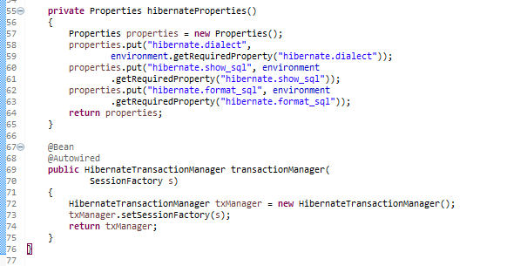
Spring 4 + Hibernate 4 + MySQL+ Maven Integration example (Annotation based configuration)
Configure Hibernate

Slide 5
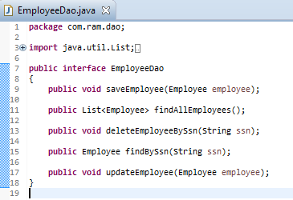
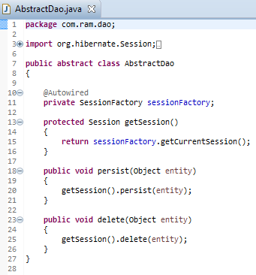
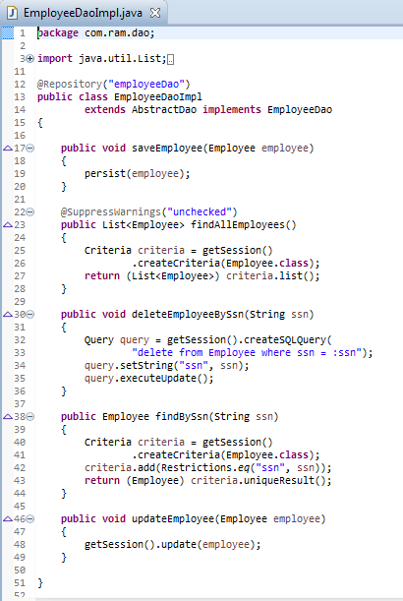
Spring 4 + Hibernate 4 + MySQL+ Maven Integration example (Annotation based configuration)
Add DAO Layer

Slide 6
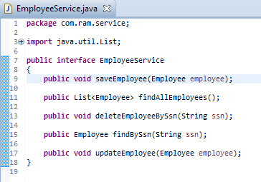
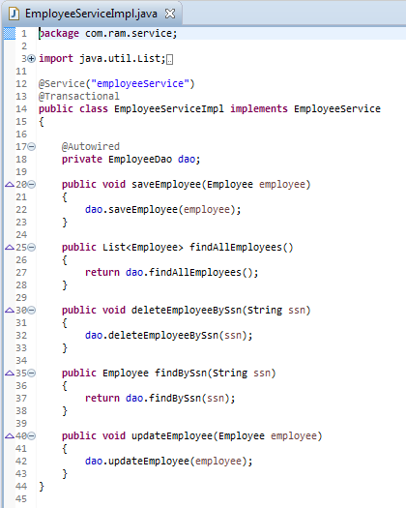
Spring 4 + Hibernate 4 + MySQL+ Maven Integration example (Annotation based configuration)
Add Service Layer

Slide 7
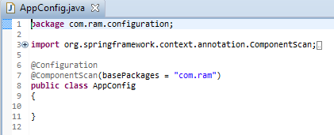
Spring 4 + Hibernate 4 + MySQL+ Maven Integration example (Annotation based configuration)
Configure Spring

Slide 8
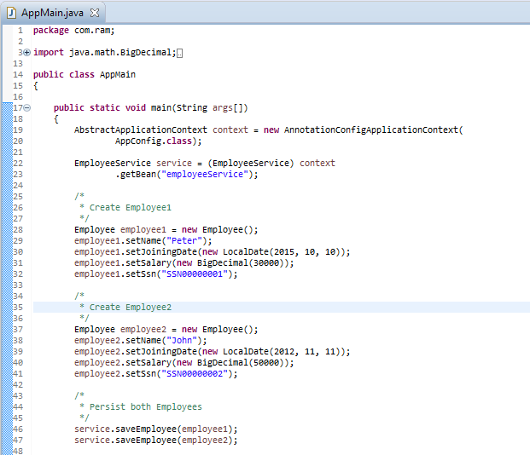
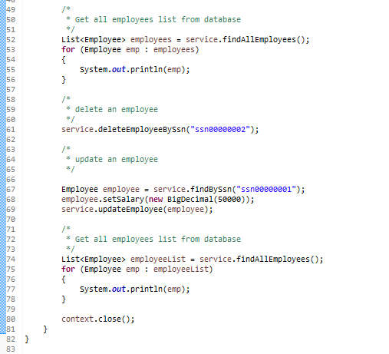
Spring 4 + Hibernate 4 + MySQL+ Maven Integration example (Annotation based configuration)
Create Main to run as Java Application

Slide 9
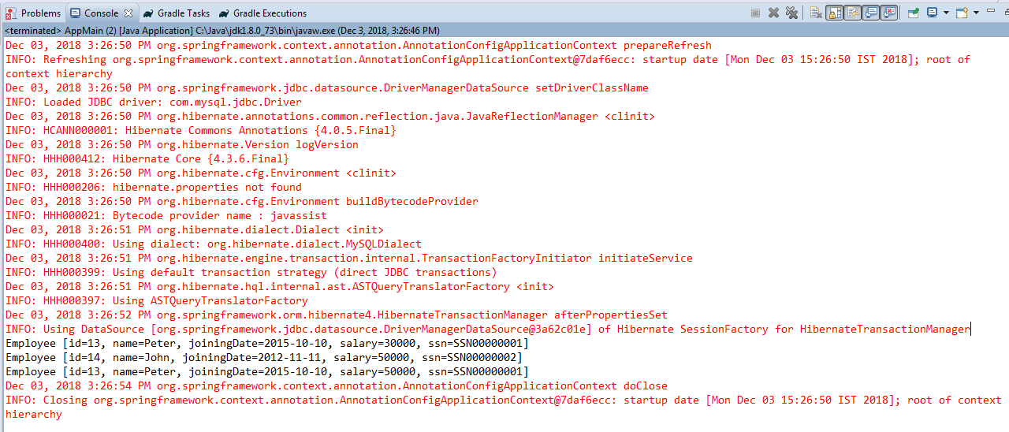
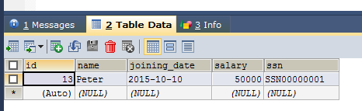
Spring 4 + Hibernate 4 + MySQL+ Maven Integration example (Annotation based configuration)

